Slide 1
Usain Bolt
The fastest man on earth

Slide 2
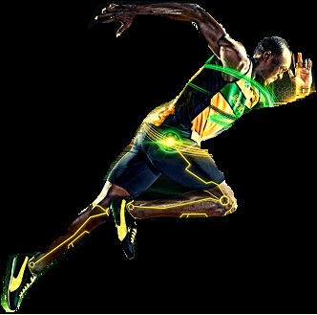
Gifted runner

Slide 3
Is the journey that smooth ????????

Slide 4
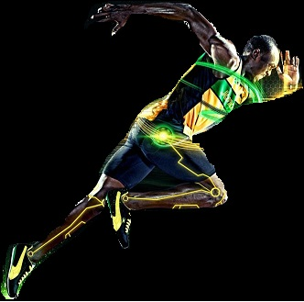
Time spoke
Yes
Yes
Yes

Slide 5
Legend
yes

